Slide 1
Tools and Techniques Charles Severance www.pg4e.com/lectures/03-Techniques.sql

Slide 2
After CREATE TABLE

Slide 3
CREATE TABLE account (
id SERIAL,
email VARCHAR(128) UNIQUE,
created_at DATE NOT NULL DEFAULT NOW(),
updated_at DATE NOT NULL DEFAULT NOW(),
PRIMARY KEY(id)
);
CREATE TABLE post (
id SERIAL,
title VARCHAR(128) UNIQUE NOT NULL,
content VARCHAR(1024), -- Will extend with ALTER
account_id INTEGER REFERENCES account(id) ON DELETE CASCADE,
created_at TIMESTAMPZ NOT NULL DEFAULT NOW(),
updated_at TIMESTAMPZ NOT NULL DEFAULT NOW(),
PRIMARY KEY(id)
);

Slide 4
-- Allow multiple comments
CREATE TABLE comment (
id SERIAL,
content TEXT NOT NULL,
account_id INTEGER REFERENCES account(id) ON DELETE CASCADE,
post_id INTEGER REFERENCES post(id) ON DELETE CASCADE,
created_at TIMESTAMPZ NOT NULL DEFAULT NOW(),
updated_at TIMESTAMPZ NOT NULL DEFAULT NOW(),
PRIMARY KEY(id)
);
CREATE TABLE fav (
id SERIAL,
oops TEXT, -- Will remove later with ALTER
post_id INTEGER REFERENCES post(id) ON DELETE CASCADE,
account_id INTEGER REFERENCES account(id) ON DELETE CASCADE,
created_at TIMESTAMPZ NOT NULL DEFAULT NOW(),
updated_at TIMESTAMPZ NOT NULL DEFAULT NOW(),
UNIQUE(post_id, account_id),
PRIMARY KEY(id)
);

Slide 5
We can adjust our schema
Sometimes you make a mistake or your application evolves
CREATE TABLE fav (
id SERIAL,
oops TEXT,
post_id INTEGER REFERENCES post(id) ON DELETE CASCADE,
account_id INTEGER REFERENCES account(id) ON DELETE CASCADE,
UNIQUE(post_id, account_id),
PRIMARY KEY(id)
);
ALTER TABLE fav DROP COLUMN oops;

Slide 6
Add, Drop , Alter columns
Can also alter indexes, uniqueness constraints, foreign keys
Can run on a live database
ALTER TABLE fav DROP COLUMN oops;
ALTER TABLE post ALTER COLUMN content TYPE TEXT;
ALTER TABLE fav ADD COLUMN howmuch INTEGER;

Slide 7
Reading commands from a file
-- https://www.pg4e.com/lectures/03-Techniques-Load.sql
-- Start fresh - Cascade deletes it all
DELETE FROM account;
ALTER SEQUENCE account_id_seq RESTART WITH 1;
ALTER SEQUENCE post_id_seq RESTART WITH 1;
ALTER SEQUENCE comment_id_seq RESTART WITH 1;
ALTER SEQUENCE fav_id_seq RESTART WITH 1;
...
discuss=> \i 03-Techniques-load.sql
DELETE 4
ALTER SEQUENCE
ALTER SEQUENCE
ALTER SEQUENCE
ALTER SEQUENCE
INSERT 0 3
INSERT 0 3
INSERT 0 5
discuss=>

Slide 8
Dates

Slide 9
Date Types (Review)
DATE - 'YYYY-MM-DD'
TIME - 'HH:MM:SS'
TIMESTAMP - 'YYYY-MM-DD HH:MM:SS' (4713 BC, 294276 AD)
TIMESTAMPTZ – "TIMESTAMP WITH TIME ZONE"
Built-in PostgreSQL function NOW()

Slide 10
Setting default values
We can save some code by auto-populating date fields when a row is INSERTed
We will auto-set on UPDATEs later…
CREATE TABLE fav (
id SERIAL,
post_id INTEGER REFERENCES post(id) ON DELETE CASCADE,
account_id INTEGER REFERENCES account(id) ON DELETE CASCADE,
created_at TIMESTAMPTZ NOT NULL DEFAULT NOW(),
updated_at TIMESTAMPTZ NOT NULL DEFAULT NOW(),
UNIQUE(post_id, account_id),
PRIMARY KEY(id)
);

Slide 11
TIMESTAMPTZ – Best Practice
Store time stamps with timezone
Prefer UTC for stored time stamps
Convert to local time zone when retrieving
discuss=> SELECT NOW(), NOW() AT TIME ZONE 'UTC', NOW() AT TIME ZONE 'HST';
now | timezone | timezone
------------------------------+---------------------------+---------------------------
2019-06-10 11:42:51.52127-04 | 2019-06-10 15:42:51.52127 | 2019-06-10 05:42:51.52127

Slide 12
PostgreSQL time zones
discuss=> SELECT * FROM pg_timezone_names;
name | abbrev | utc_offset | is_dst
----------------------------------+--------+------------+--------
Indian/Mauritius | +04 | 04:00:00 | f
Indian/Chagos | +06 | 06:00:00 | f
Indian/Mayotte | EAT | 03:00:00 | f
Indian/Christmas | +07 | 07:00:00 | f
Indian/Cocos | +0630 | 06:30:00 | f
Indian/Comoro | EAT | 03:00:00 | f
discuss=> SELECT * FROM pg_timezone_names WHERE name LIKE '%Hawaii%';
name | abbrev | utc_offset | is_dst
-----------+--------+------------+--------
US/Hawaii | HST | -10:00:00 | f

Slide 13
Casting to different types
We use the phrase 'casting' to mean convert from one type to another
Postgres has several forms of casting
postgres=# SELECT NOW()::DATE, CAST(NOW() AS DATE), CAST(NOW() AS TIME);
now | now | now
------------+------------+-----------------
2019-06-10 | 2019-06-10 | 11:45:42.899995

Slide 14
Intervals
We can do date interval arithmetic
postgres=# SELECT NOW(), NOW() - INTERVAL '2 days', (NOW() - INTERVAL '2 days')::DATE;
now | ?column? | date
-------------------------------+-------------------------------+------------
2019-06-10 11:56:34.886679-04 | 2019-06-08 11:56:34.886679-04 | 2019-06-08

Slide 15
Using date_trunc()
Sometimes we want to discard some of the accuracy that is in a TIMESTAMP
discuss=> SELECT id, content, created_at FROM comment
discuss-> WHERE created_at >= DATE_TRUNC('day',NOW())
discuss-> AND created_at < DATE_TRUNC('day',NOW() + INTERVAL '1 day');
id | content | created_at
----+-------------------------------------------------------+------------
11 | I agree | 2019-06-10
12 | Especially for counting | 2019-06-10
13 | And I don't understand why | 2019-06-10
14 | Someone should make "EasySoup" or something like that | 2019-06-10
15 | Good idea - I might just do that | 2019-06-10

Slide 16
Performance: Table Scans
Not all equivalent queries have the same performance
discuss=> SELECT id, content, created_at FROM comment
discuss-> WHERE created_at::DATE = NOW()::DATE;
id | content | created_at
----+-------------------------------------------------------+------------
11 | I agree | 2019-06-10
12 | Especially for counting | 2019-06-10
13 | And I don't understand why | 2019-06-10
14 | Someone should make "EasySoup" or something like that | 2019-06-10
15 | Good idea - I might just do that | 2019-06-10

Slide 17
DISTINCT / GROUP BY

Slide 18
Reducing the result set
DISTINCT only returns unique rows in a result set – and row will only appear once
DISTINCT ON limits duplicate removal to a set of columns
GROUP BY is combined with aggregate functions like COUNT(), MAX(), SUM(), AVE() …

Slide 19
Reducing a result set
PostgreSQL
make | model
--------+---------
Nissan | Stanza
Dodge | Neon
Dodge | Neon
Dodge | Neon
SELECT
make | model
--------+---------
Nissan | Stanza
Dodge | Neon
DISTINCT

Slide 20
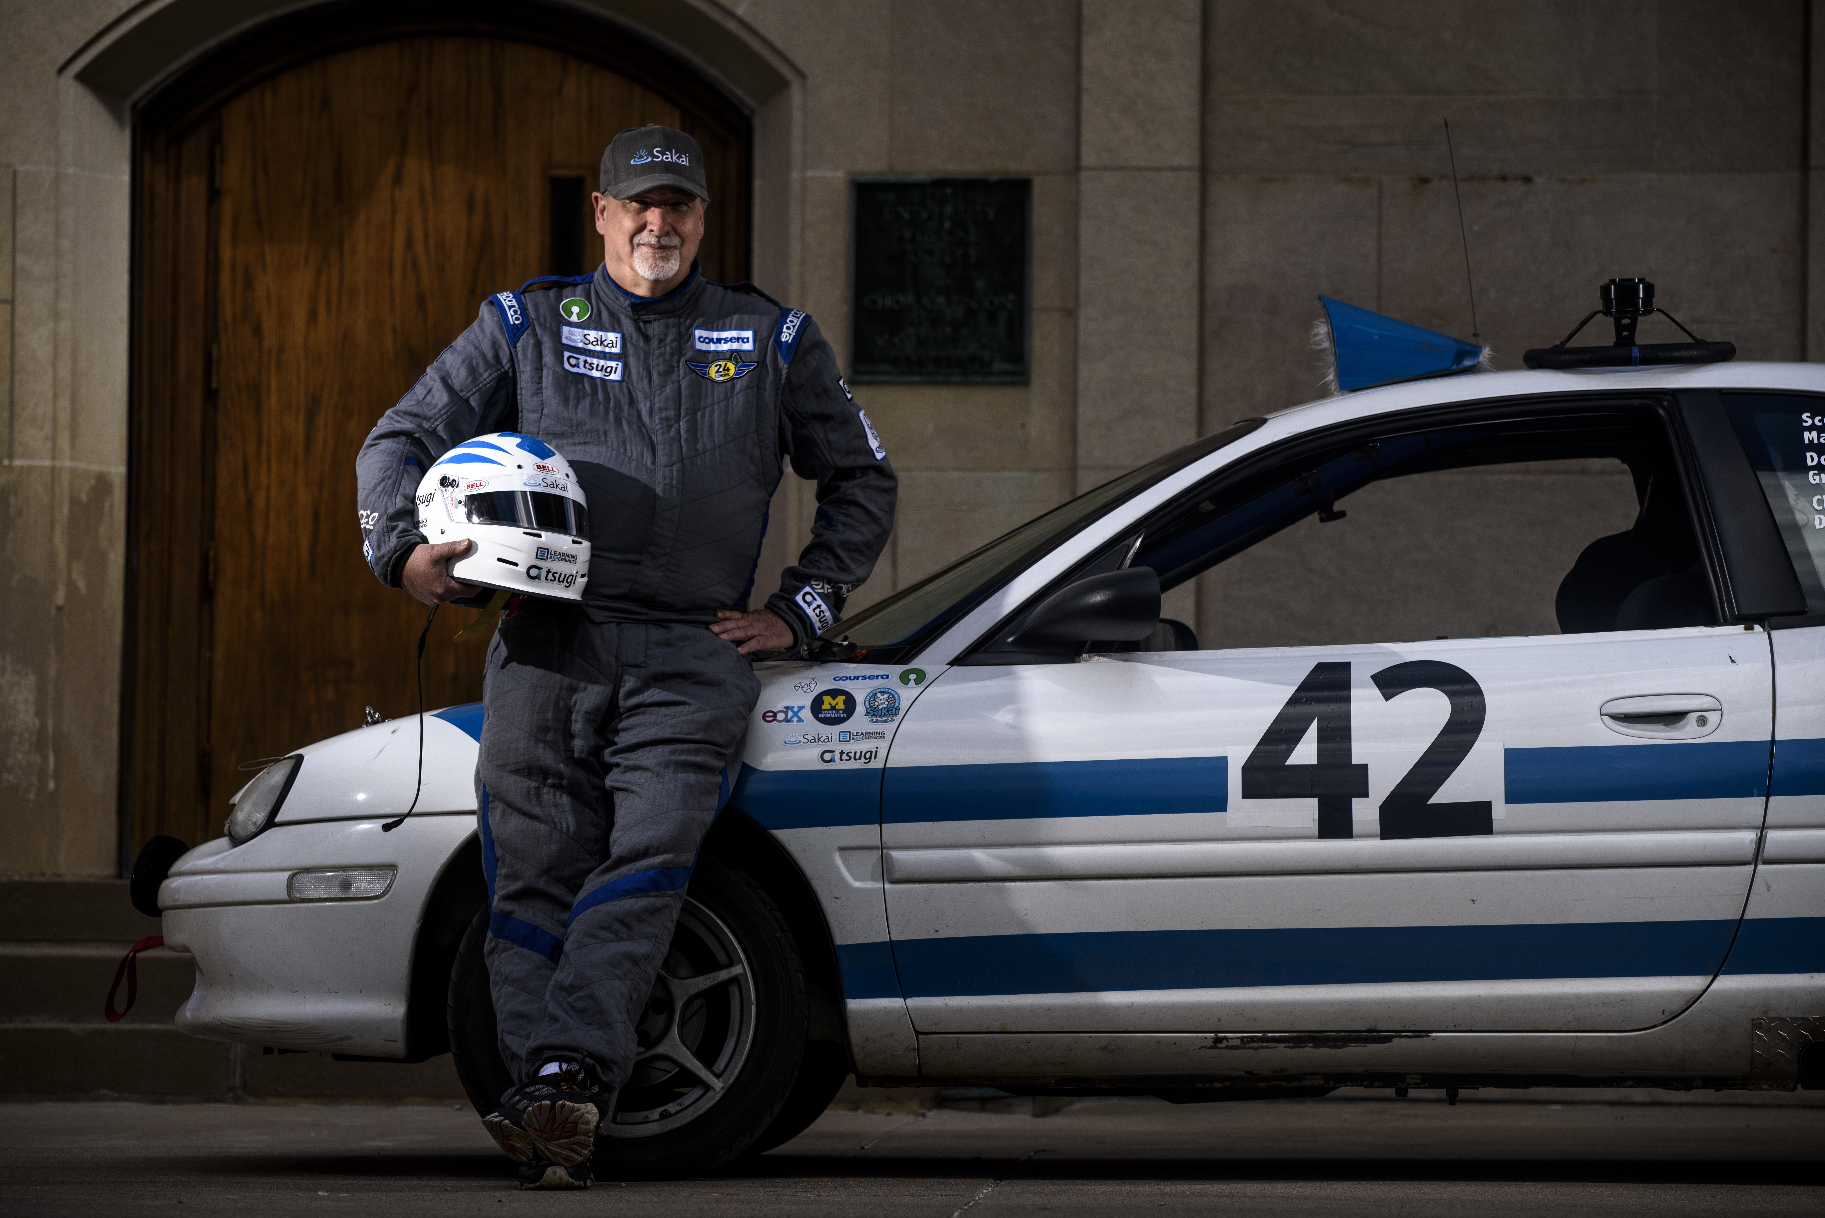
Racing Data
discuss=> select * from racing;
make | model | year | price
--------+---------+------+-------
Nissan | Stanza | 1990 | 2000
Dodge | Neon | 1995 | 800
Dodge | Neon | 1998 | 2500
Dodge | Neon | 1999 | 3000
Ford | Mustang | 2001 | 1000
Ford | Mustang | 2005 | 2000
Subaru | Impreza | 1997 | 1000
Mazda | Miata | 2001 | 5000
Mazda | Miata | 2001 | 3000
Mazda | Miata | 2001 | 2500
Mazda | Miata | 2002 | 5500
Opel | GT | 1972 | 1500
Opel | GT | 1969 | 7500
Opel | Cadet | 1973 | 500

Slide 21
make | model | year | price
--------+---------+------+-------
Nissan | Stanza | 1990 | 2000
Dodge | Neon | 1995 | 800
Dodge | Neon | 1998 | 2500
Dodge | Neon | 1999 | 3000
Ford | Mustang | 2001 | 1000
Ford | Mustang | 2005 | 2000
Subaru | Impreza | 1997 | 1000
Mazda | Miata | 2001 | 5000
Mazda | Miata | 2001 | 3000
Mazda | Miata | 2001 | 2500
Mazda | Miata | 2002 | 5500
Opel | GT | 1972 | 1500
Opel | GT | 1969 | 7500
Opel | Cadet | 1973 | 500
SELECT DISTINCT model FROM racing;
model
--------
Stanza
Neon
Mustang
Impreza
Miata
GT
Cadet

Slide 22
make | model | year | price
--------+---------+------+-------
Nissan | Stanza | 1990 | 2000
Dodge | Neon | 1995 | 800
Dodge | Neon | 1998 | 2500
Dodge | Neon | 1999 | 3000
Ford | Mustang | 2001 | 1000
Ford | Mustang | 2005 | 2000
Subaru | Impreza | 1997 | 1000
Mazda | Miata | 2001 | 5000
Mazda | Miata | 2001 | 3000
Mazda | Miata | 2001 | 2500
Mazda | Miata | 2002 | 5500
Opel | GT | 1972 | 1500
Opel | GT | 1969 | 7500
Opel | Cadet | 1973 | 500
SELECT DISTINCT ON (model)
make,model FROM racing;
make | model
--------+---------
Opel | Cadet
Opel | GT
Subaru | Impreza
Mazda | Miata
Ford | Mustang
Dodge | Neon
Nissan | Stanza

Slide 23
Lets play with time zones
discuss=> SELECT * FROM pg_timezone_names;
name | abbrev | utc_offset | is_dst
----------------------------------+--------+------------+--------
Indian/Mauritius | +04 | 04:00:00 | f
Indian/Chagos | +06 | 06:00:00 | f
Indian/Mayotte | EAT | 03:00:00 | f
Indian/Christmas | +07 | 07:00:00 | f
Indian/Cocos | +0630 | 06:30:00 | f
Indian/Comoro | EAT | 03:00:00 | f
discuss=> SELECT * FROM pg_timezone_names WHERE name LIKE '%Hawaii%';
name | abbrev | utc_offset | is_dst
-----------+--------+------------+--------
US/Hawaii | HST | -10:00:00 | f

Slide 24
Aggregate / GROUP BY
discuss=> SELECT COUNT(abbrev), abbrev FROM pg_timezone_names GROUP BY abbrev;
count | abbrev
-------+--------
2 | +00
1 | PST
4 | IST
2 | -01
4 | HST
6 | +09
15 | +05
7 | ADT
1 | -12
...

Slide 25
HAVING clause
discuss=> SELECT COUNT(abbrev) AS ct, abbrev FROM pg_timezone_names
discuss-> WHERE is_dst= 't' GROUP BY abbrev HAVING COUNT(abbrev) > 10;
ct | abbrev
----+--------
12 | PDT
22 | EEST
24 | CDT
36 | CEST
28 | EDT
15 | MDT

Slide 26
Sub-Queries

Slide 27
A query within an query
Can use a value or set of values in a query that are computed by another query
SELECT * FROM account
WHERE email='ed@umich.edu';
SELECT content FROM comment
WHERE account_id = 7;
SELECT content FROM comment
WHERE account_id = (SELECT id FROM account WHERE email='ed@umich.edu');

Slide 28
Sub Query
PostgreSQL
content
--------------
Hello World
SELECT
SELECT
id
----
7

Slide 29
HAVING clause
discuss=> SELECT COUNT(abbrev) AS ct, abbrev FROM pg_timezone_names
discuss-> WHERE is_dst= 't' GROUP BY abbrev HAVING COUNT(abbrev) > 10;
ct | abbrev
----+--------
12 | PDT
22 | EEST
24 | CDT
36 | CEST
28 | EDT
15 | MDT

Slide 30
Using a Sub-Query
discuss=> SELECT ct, abbrev FROM
discuss-> (
discuss-> SELECT COUNT(abbrev) AS ct, abbrev
discuss-> FROM pg_timezone_names
discuss-> WHERE is_dst = 't' GROUP BY abbrev
discuss-> ) AS zap
discuss-> WHERE ct > 10;
ct | abbrev
----+--------
12 | PDT
22 | EEST
24 | CDT
36 | CEST
28 | EDT
15 | MDT

Slide 31
Concurrency

Slide 32
Concurrency
UPDATE tracks SET count=count+1
WHERE id = 42
Databases are designed to accept SQL commands from a variety of sources simultaneously and perform them atomically
PostgreSQL
42 | 100
UPDATE tracks SET count=count+1
WHERE id = 42
UPDATE tracks SET count=count+1
WHERE id = 42

Slide 33
Transactions and Atomicity
To implement atomicity, PostgreSQL "locks" areas before it starts an SQL command that might change an area of the database
All other access to that area must wait until the area is unlocked
LOCK ROW 42 OF tracks
READ count FROM tracks ROW 42
count = count + 1
WRITE count TO tracks ROW 42
UNLOCK ROW 42 OF tracks
UPDATE tracks
SET count=count+1
WHERE id = 42

Slide 34
Single SQL Statements are Atomic
All the inserts will work and get a unique primary key
Which account gets which key is not predictable
INSERT INTO account(email)
VALUES('ed@umich.edu');
INSERT INTO account(email)
VALUES('sue@umich.edu');
INSERT INTO account(email)
VALUES('sally@umich.edu');
PostgreSQL

Slide 35
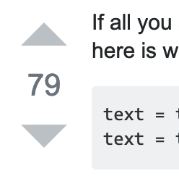
Compound Statements
There are statements which do more than one thing in one statement for efficiency and concurrency.
INSERT INTO fav (post_id, account_id, howmuch)
VALUES (1,1,1)
RETURNING *;
UPDATE fav SET howmuch=howmuch+1
WHERE post_id = 1 AND account_id = 1
RETURNING *;

Slide 36
ON CONFLICT
Sometimes you "bump into" a constraint on purpose
-- This will fail
INSERT INTO fav (post_id, account_id, howmuch)
VALUES (1,1,1)
RETURNING *;
INSERT INTO fav (post_id, account_id, howmuch)
VALUES (1,1,1)
ON CONFLICT (post_id, account_id)
DO UPDATE SET howmuch = fav.howmuch + 1
RETURNING *;

Slide 37
Multi-Statement Transactions
BEGIN;
SELECT howmuch FROM fav WHERE account_id=1 AND post_id=1 FOR UPDATE OF fav;
-- Time passes...
UPDATE SET howmuch=999 WHERE account_id=1 AND post_id=1;
ROLLBACK;
SELECT howmuch FROM fav WHERE account_id=1 AND post_id=1;
BEGIN;
SELECT howmuch FROM fav WHERE account_id=1 AND post_id=1 FOR UPDATE OF fav;
-- Time passes...
UPDATE SET howmuch=999 WHERE account_id=1 AND post_id=1;
COMMIT;
SELECT howmuch FROM fav WHERE account_id=1 AND post_id=1;
Play with this with two windows open ☺

Slide 38
Transactions and Performance
The implementation of transactions makes a big difference in database performance
Lock granularity
Lock implementation

Slide 39
Transaction Topics
Lock strength UPDATE, NO KEY UPDATE
What to do when encountering a lock (WAIT), NOWAIT, SKIP LOCKED

Slide 40
Stored Procedures

Slide 41
Stored Procedures
A stored procedure is a bit of reusable code that runs inside of the database server
Technically there are multiple language choices but just use "plpgsql"
Generally quite non-portable
Usually the goal is to to have fewer SQL statements

Slide 42
Stored Procedures
You should have a strong reason to use a stored procedure
Major performance problem
Harder to test / modify
No database portability
Some rule that *must* be enforced

Slide 43
Recall
CREATE TABLE fav (
id SERIAL,
post_id INTEGER REFERENCES post(id) ON DELETE CASCADE,
account_id INTEGER REFERENCES account(id) ON DELETE CASCADE,
created_at TIMESTAMPZ NOT NULL DEFAULT NOW(),
updated_at TIMESTAMPZ NOT NULL DEFAULT NOW(),
UNIQUE(post_id, account_id),
PRIMARY KEY(id)
);
UPDATE fav SET howmuch=howmuch+1
WHERE post_id = 1 AND account_id = 1;
UPDATE fav SET howmuch=howmuch+1, updated_at=NOW()
WHERE post_id = 1 AND account_id = 1;

Slide 44
Using a trigger for updated_at
CREATE OR REPLACE FUNCTION trigger_set_timestamp()
RETURNS TRIGGER AS $$
BEGIN
NEW.updated_at = NOW();
RETURN NEW;
END;
$$ LANGUAGE plpgsql;
CREATE TRIGGER set_timestamp
BEFORE UPDATE ON fav
FOR EACH ROW
EXECUTE PROCEDURE trigger_set_timestamp();
UPDATE fav SET howmuch=howmuch+1
WHERE post_id = 1 AND account_id = 1;

Slide 45
DEMO Reading and Parsing Files

Slide 46
CSV -> Normalized Database
discuss=> select * from xy;
id | x | y_id
----+-----+------
1 | Zap | 2
2 | Zip | 2
3 | One | 1
4 | Two | 1
discuss=> select * from y;
id | y
----+---
1 | B
2 | A
03-Techniques.csv :
Zap,A
Zip,A
One,B
Two,B
DEMO

Slide 47
Summary

Slide 48
https://www.postgresql.org/docs/11/sql-select.html
SELECT [ ALL | DISTINCT [ ON ( expression [, ...] ) ] ]
[ * | expression [ [ AS ] output_name ] [, ...] ]
[ FROM from_item [, ...] ]
[ WHERE condition ]
[ GROUP BY grouping_element [, ...] ]
[ HAVING condition [, ...]
[ ORDER BY expression [ ASC | DESC | USING operator ]
[ LIMIT { count | ALL } ] [ OFFSET start [ ROW | ROWS ] ]
[ FOR { UPDATE | NO KEY UPDATE | SHARE | KEY SHARE }
[ OF table_name [, ...] ] [ NOWAIT | SKIP LOCKED ] [...] ]

Slide 49
Acknowledgements / Contributions
These slides are Copyright 2019- Charles R. Severance (www.dr-chuck.com) as part of www.pg4e.com and made available under a Creative Commons Attribution 4.0 License. Please maintain this last slide in all copies of the document to comply with the attribution requirements of the license. If you make a change, feel free to add your name and organization to the list of contributors on this page as you republish the materials.
Initial Development: Charles Severance, University of Michigan School of Information
Insert new Contributors and Translators here including names and dates
Continue new Contributors and Translators here

